Slide 1
Hammerites PI2004k
Member 1 06_Hairulsham
Member 2 05_Mohd_afif
Member 3 20_Alvin_quek

Slide 2
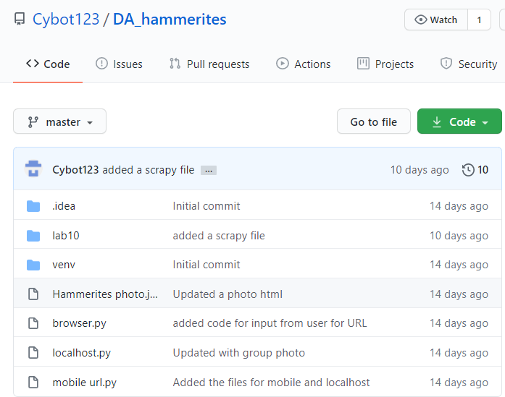
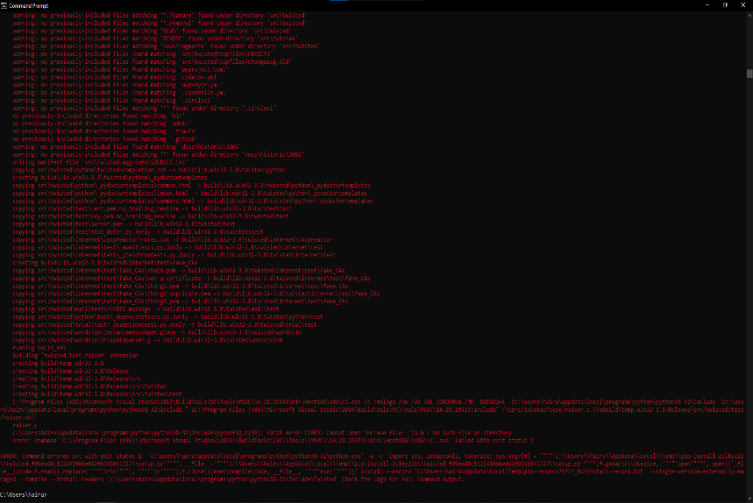
06 HAirulsham Log
Task: VCS
The feature of VCS it provide web address to access project: https://github.com/Cybot123/DA_hammerites
There is no problem with the VCS.
For Image location scrapping :
The feature is Scrap image link and store in json text
The problem we encountered is Scrapy windows cannot use window 10 command prompt .
The solution we did is we installed Anaconda to make it work.

Slide 3
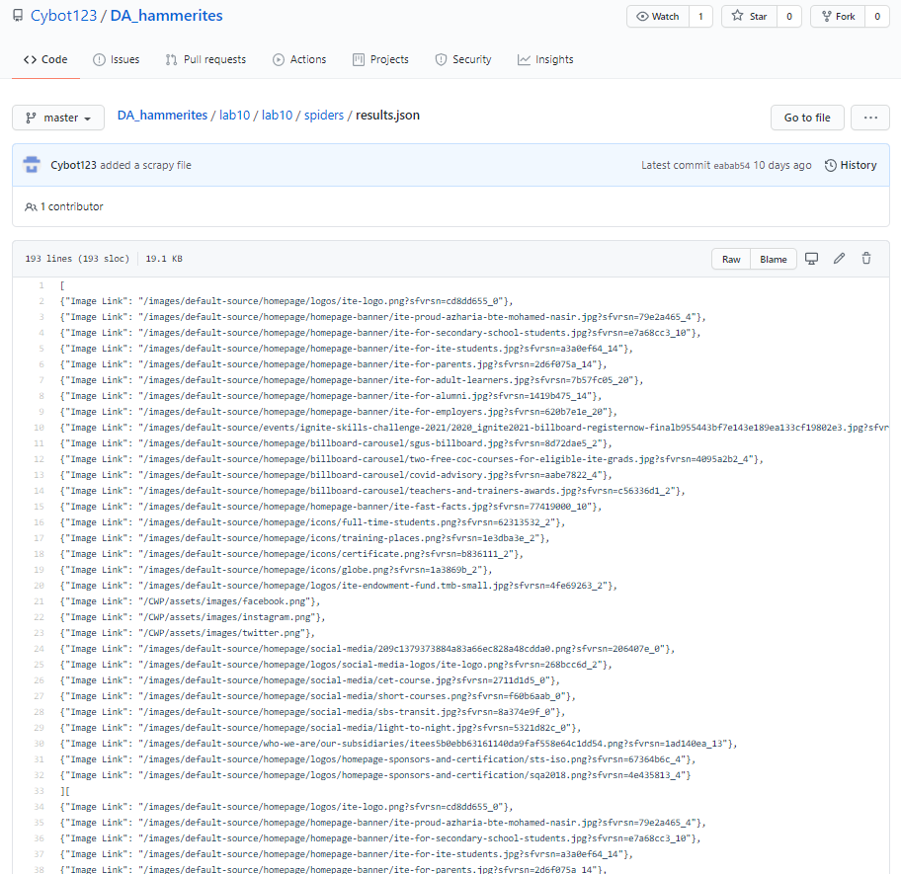
06 HAirulsham Log
Additional scraping
Feature is Scrap text and store in text folder.
There is no issue on this topic.

Slide 4
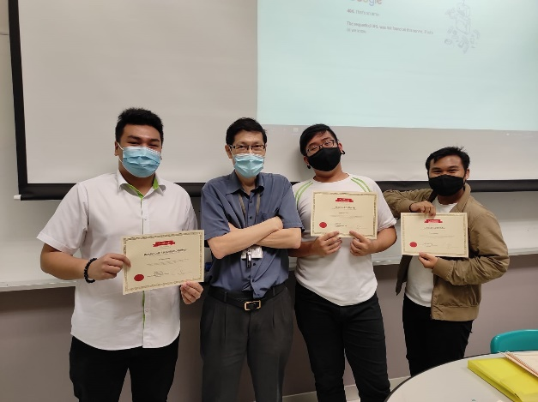



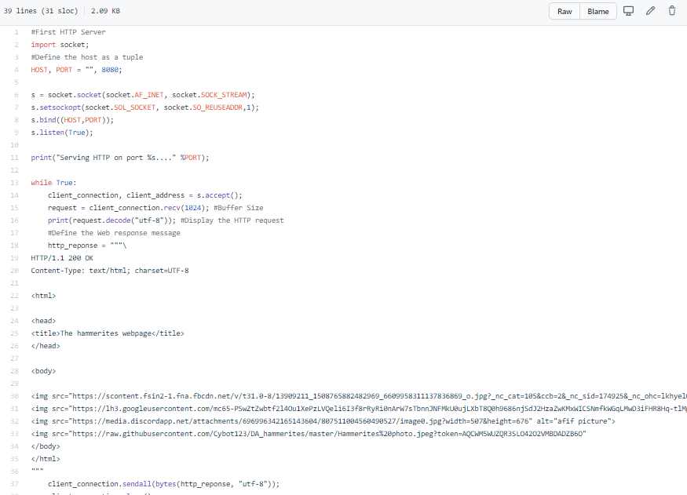
05 Mohd Afif Log 20 Alvin quek LOG
Task server Lab10 A
Http service:
The feature is to create a http service in python and display a output in the http server and pictures.
There is no problem doing this.
Port 8080 :
The feature is to listen to the and response with http.
There is no problem doing this.

Slide 5
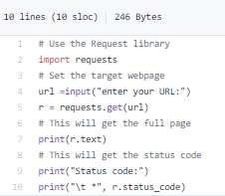
05 Mohd Afif Log 20 Alvin quek LOG
Task server Lab10 B
Browser.py :
The feature is to connect to webserver using the browser script.
There is no problem doing this.
Request get :
Is to request for the url.
There is no problem doing this.

Slide 6
05 Mohd Afif Log 20 Alvin quek LOG
Task Scrapy to get image location and additional scraping.
the scripts created in the extra file has codes that resembles a web crawler board that only searches for keywords , in this case its the author name and few words that are link to the sentence

